Slide 1

Prediction of DFL donations
Dylan Zetah

Slide 2
Introduction

Slide 3
Main Objectives
Analyze 1000 survey responses from after 2020 election
1
Response: Total donations to DFL groups in 2020
Explanatory: Age, college education, yearly income, gender, race, ethnicity, and location
Build a predictive model
2
Assess and compare predictive accuracy
3
Zero Inflated Gaussian
Random Forest Regression
K-Fold Cross validation using MSE

Slide 4
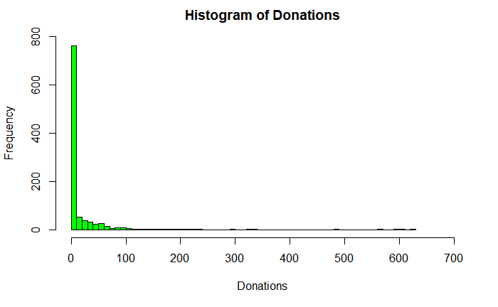
Initial Analysis
Biggest problem = excess zeros
About 70% of participants did not donate at all
Two approaches:
Zero inflated model
Random forest regression

Slide 5
Methods

Slide 6
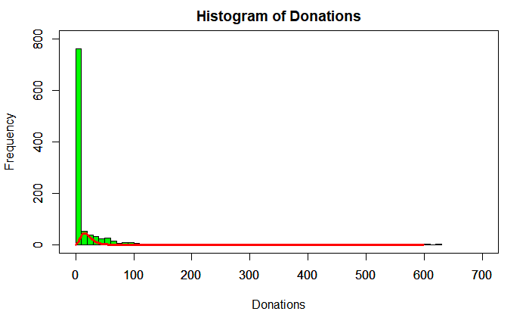
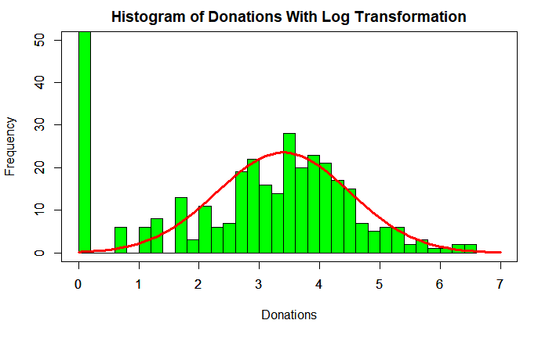
Zero Inflated Models
~ Negbin(µ=20,size = 20)
Used when handling data that has zeros which are not explained by a distribution
Zero Inflated Poisson
Zero Inflated Negative Binomial
Zero Inflated Gaussian
Assumes the zeros in the data fall under 2 categories
“natural zeros”
“excess zeros”
~ Normal(µ=3.4,σ = 1)

Slide 7
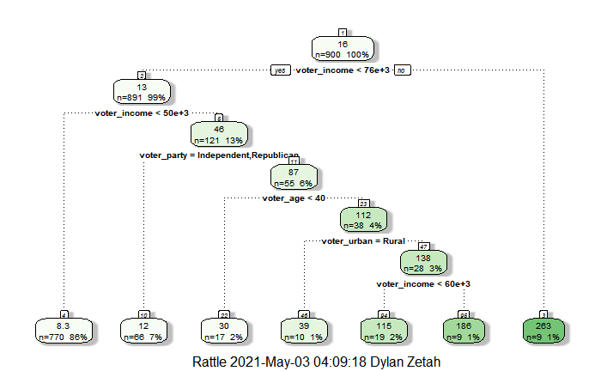
Random Forest Regression
Regression trees -> Bagging -> Random Forest
Similar to bootstrapping
New tree is made from each random sample
Averaging all trees reduces variance
Only 3 predictors are used in each tree
Allows less influential variables to be explored more
No assumptions made on distribution

Slide 8
K-Fold Cross Validation
Split
Split data into 10 “folds”
Assign
Assign 1st fold to be validation set, rest of the data is training set
Build
Build model with training set and obtain MSE from validation set
Repeat
Repeat for 9 other “folds”
Average
Average results to obtain cross validated MSE

Slide 9
Results

Slide 10
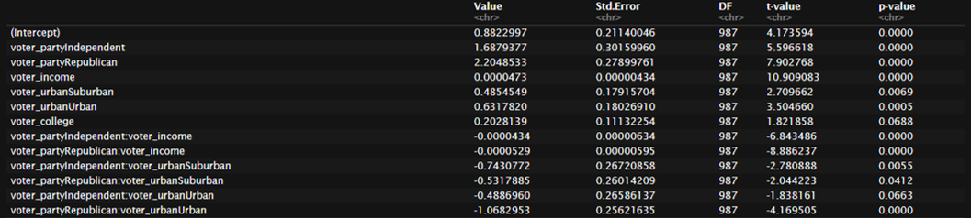
Zero Inflated Gaussian

Slide 11
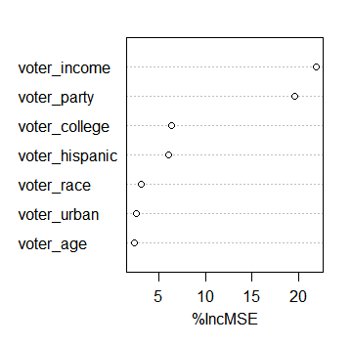
Random Forest Regression
% increase of MSE measures effect of randomly permuting variables on test MSE
Removed voter gender from model
Voter income and party affiliation are largest by far

Slide 12
Cross Validation
 | Zero Inflated Gaussian | Random Forest Regression
Cross Validated MSE | 1732.13 | 1507.22
Mean Error | 41.61 | 38.82

Slide 13
Discussion

Slide 14
Model Comparison
Zero Inflated Gaussian
Random Forest Regression
Income, party, location, and education were most influential
Cross Validated MSE of 1732.13
Easier to interpret
Interactions between income and party/location
Income, party, education, and ethnicity were most influential
Cross validated MSE of 1507.22
Lacks an easy interpretation

Slide 15
Groups to Target
Anyone with a high yearly income (>50,000$)
Members of the DFL party
College educated
Urban Voters

Slide 16
Thank you for listening
Any Questions?

